Slide 1
Air-line Reservation
Presented By
P.Anusha
J.Sruthi
J.Ramireddy

Slide 2
Introduction
“Air-Line Reservation” is to provide the Reservation of Domestic and International Flights.
This function displays the appropriate flights information for selection.

Slide 3
Specification
This Project facilitates the administrator to login to login form.
And make the user to book reservations in Airlines either using Domestic flights and international flights .

Slide 4
One of the crucial activities in the development of a system is feasibility study.
The system is feasibile for following aspects
Technical
Economic
Operational

Slide 5
Requirements
Softwares :
Technologies : core java
Operating System : Windows2000Prof/XP.
Hardwares :
Processor : Intel Pentium based system
Processor Speed : 250 MHz to 833MHz
RAM : 128 MB to 2 GB

Slide 6
Modules
Domestic Flights.
International Flights.

Slide 7
Domestic Flights
The administrator allows the user to view his details.
Domestic flight table is viewed.
It displays another window with all the details we entered.

Slide 8
If we have no access it displays “You have no access” .
If there are no seats available it displays “sorry seats are full”.

Slide 9
International Flights
The administrator has to enter all the details like From,to,Adults,Infants,children,Date,Economic/Buisiness .
Book the International flight tickets.

Slide 10
Proposed System
Need not spend much time in booking, the ticket.
Server is built so that takes care of every transaction.

Slide 11
Existing System
The clerk has to search all the records present manually one by one.
Due to which other’s would be waiting for their turn for a long time.

Slide 12
Features
Aquiring flights information.
Availability of accommodation in flights.
Preferred service class.

Slide 13
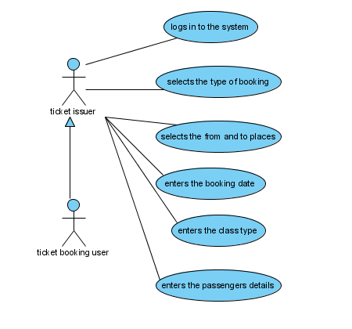
UML

Slide 14
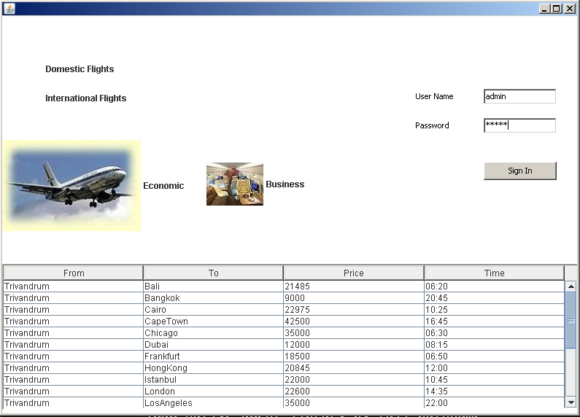
Login Page

Slide 15
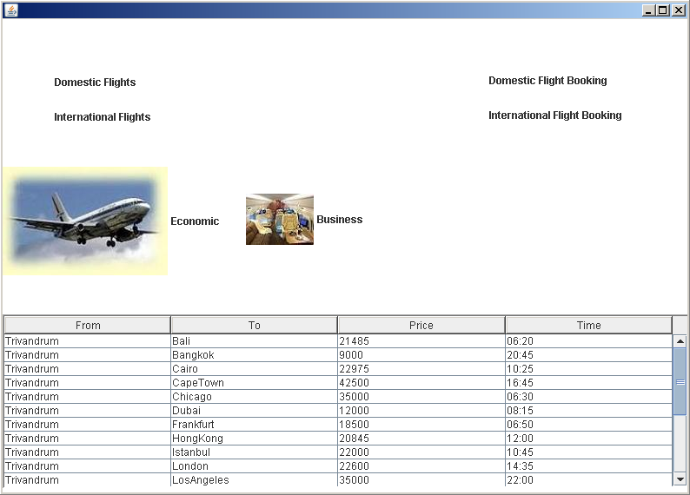
Logged in Page

Slide 16
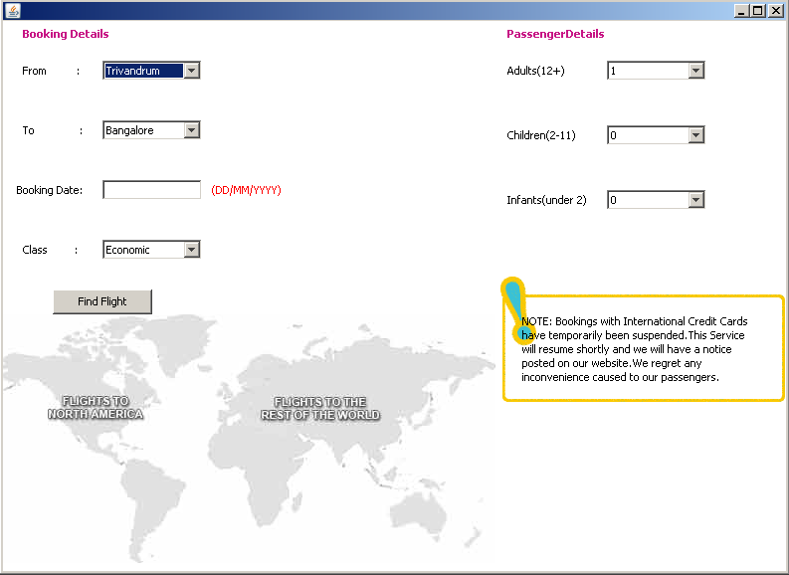
Domestic Flight Booking

Slide 17
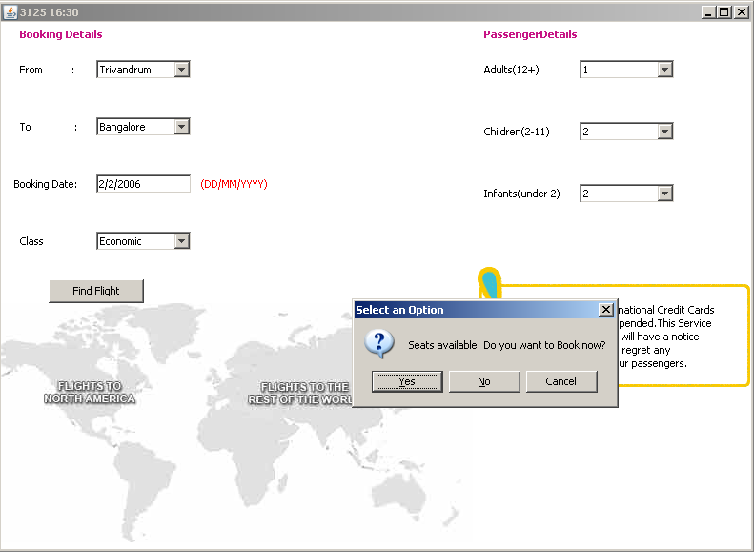
For Booking A Flight

Slide 18
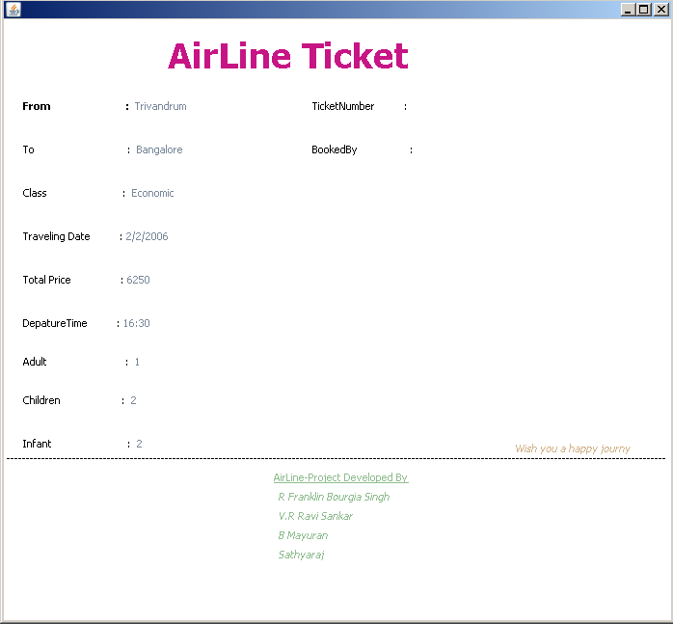
Booked Flight Screen

Slide 19

Acknowledgement
Our sincere Thanks to sir for providing a Opportunity and encouragement for publishing mini project and we are very much thanks.

